Slide 1
Unix Process Management
Caryl Rahn

Slide 2
Processes Overview
1. What is a Process?
2. fork()
3. exec()
4. wait()
5. Process Data
6. File Descriptors across Processes
7. Special Exit Cases
8. IO Redirection
9. User/Group ID real and effective
10. getenv/putenv, ulimit()

Slide 3
What is a Process?
A process is an executing program.
A process:
  $ cat file1 file2 &
Two processes:
  $ ls | wc - l
Each user can run many processes at once
(e.g. using &)
Notes:
When you execute a program on your UNIX system, the system creates a special environment for that program. This environment contains everything needed for the system to run the program as if no other program were running on the system.
Whenever you issue a command in UNIX, it creates, or starts, a new process. When you tried out the ls command to list directory contents, you started a process. A process, in simple terms, is an instance of a running program.
The operating system tracks processes through a five digit ID number known as the pid or process ID . Each process in the system has a unique pid.
Pids eventually repeat because all the possible numbers are used up and the next pid rolls or starts over. At any one time, no two processes with the same pid exist in the system because it is the pid that UNIX uses to track each process.

Slide 4
A More Precise Definition
A process is the context (the information/data) maintained for an executing program.
Intuitively, a process is the abstraction of a physical processor.
  Exists because it is difficult for the OS to otherwise coordinate many concurrent activities, such as incoming network data, multiple users, etc.
IMPORTANT: A process is sequential

Slide 5
Process Birth and Death
Creation | Termination
New batch job | Normal Completion
Interactive Login | Memory unavailable
Created by OS to provide a service | Protection error
Spawned by existing process | Operator or OS Intervention
Notes:
There are many reasons why a process may be created or terminated.

Slide 6
Process Creation
The OS builds a data structure to manage the process
Traditionally, the OS created all processes
  But it can be useful to let a running process create another
This action is called process spawning
  Parent Process is the original, creating, process
  Child Process is the new process
Notes:
Typically, the “related” processes need to communicate and cooperate with each other. Achieving this cooperation is a difficult task for the programmer; discussed further in Chapter 5.

Slide 7
Process Termination
There must be some way that a process can indicate completion.
This indication may be:
  A HALT instruction generating an interrupt alert to the OS.
  A user action (e.g. log off, quitting an application)
  A fault or error
  Parent process terminating

Slide 8
What makes up a Process?
program code
machine registers
global data
stack
open files (file descriptors)
an environment (environment variables; credentials for security)

Slide 9
Some of the Context Information
  Process ID (pid) unique integer
  Parent process ID (ppid)
  Real User ID ID of user/process which started this process
  Effective User ID ID of user who wrote the process’ program
  Current directory
  File descriptor table
  Environment VAR=VALUE pairs
continued

Slide 10
  Pointer to program code
  Pointer to data Memory for global vars
  Pointer to stack Memory for local vars
  Pointer to heap Dynamically allocated
  Execution priority
  Signal information

Slide 11
Important System Processes
init – Mother of all processes. init is started at boot time and is responsible for starting other processes.
getty – login process that manages login sessions.

Slide 12
Foreground & Background
When you start a process (run a command), there are two ways you can run it −
  Foreground Processes
  Background Processes
Notes:
Starting a Process
Foreground Processes
By default, every process that you start runs in the foreground. It gets its input from the keyboard and sends its output to the screen.
You can see this happen with the ls command. If I want to list all the files in my current directory, I can use the following command −
$ls ch*.docThis would display all the files whose name start with ch and ends with .doc −
ch01-1.doc ch010.doc ch02.doc ch03-2.doc ch04-1.doc ch040.doc ch05.doc ch06-2.doc ch01-2.doc ch02-1.docThe process runs in the foreground, the output is directed to my screen, and if the ls command wants any input (which it does not), it waits for it from the keyboard.
While a program is running in foreground and taking much time, we cannot run any other commands (start any other processes) because prompt would not be available until program finishes its processing and comes out.
Background Processes
A background process runs without being connected to your keyboard. If the background process requires any keyboard input, it waits.
The advantage of running a process in the background is that you can run other commands; you do not have to wait until it completes to start another!
The simplest way to start a background process is to add an ampersand ( &) at the end of the command.
$ls ch*.doc &This would also display all the files whose name start with ch and ends with .doc −
ch01-1.doc ch010.doc ch02.doc ch03-2.doc ch04-1.doc ch040.doc ch05.doc ch06-2.doc ch01-2.doc ch02-1.docHere if the ls command wants any input (which it does not), it goes into a stop state until I move it into the foreground and give it the data from the keyboard.
That first line contains information about the background process - the job number and process ID. You need to know the job number to manipulate it between background and foreground.
If you press the Enter key now, you see the following −
[1] + Done ls ch*.doc & $The first line tells you that the ls command background process finishes successfully. The second is a prompt for another command.

Slide 13
Foreground Processes
By default, every process that you start runs in the foreground. It gets its input from the keyboard and sends its output to the screen.
You can see this happen with the ls command. If I want to list all the files in my current directory, I can use the following command −
$ls ch*.docThis would display all the files whose name start with ch and ends with .doc −
Notes:
ch01-1.doc ch010.doc ch02.doc ch03-2.doc ch04-1.doc ch040.doc ch05.doc ch06-2.doc ch01-2.doc ch02-1.docThe process runs in the foreground, the output is directed to my screen, and if the ls command wants any input (which it does not), it waits for it from the keyboard.
While a program is running in foreground and taking much time, we cannot run any other commands (start any other processes) because prompt would not be available until program finishes its processing and comes out.

Slide 14
Background Processes
A background process runs without being connected to your keyboard. If the background process requires any keyboard input, it waits.
The advantage of running a process in the background is that you can run other commands; you do not have to wait until it completes to start another!
The simplest way to start a background process is to add an ampersand ( &) at the end of the command.
$ls ch*.doc &This would also display all the files whose name start with ch and ends with .doc −
Notes:
ch01-1.doc ch010.doc ch02.doc ch03-2.doc ch04-1.doc ch040.doc ch05.doc ch06-2.doc ch01-2.doc ch02-1.doc
Here if the ls command wants any input (which it does not), it goes into a stop state until I move it into the foreground and give it the data from the keyboard.
That first line contains information about the background process - the job number and process ID. You need to know the job number to manipulate it between background and foreground.
If you press the Enter key now, you see the following −
[1] + Done ls ch*.doc & $The first line tells you that the ls command background process finishes successfully. The second is a prompt for another command.

Slide 15
Listing Running Processes
Ps
Ps -f
UID
PID
PPID
C
STIME
TTY
TIME
CMD

Slide 16
ps options
-a Shows information about all users
-x Shows information about processes without terminals
-u Shows additional information like –f option
-e Display extended information

Slide 17
Stopping Processes
Ctrl + c
  Default interrupt character works in foregroud mode
kill
Kill -9

Slide 18
Miscellaneous Process Info
Zombie and orphan Processes
Daemon Processes
top command
Notes:
Zombie and Orphan Processes
Normally, when a child process is killed, the parent process is told via a SIGCHLD signal. Then the parent can do some other task or restart a new child as needed. However, sometimes the parent process is killed before its child is killed. In this case, the "parent of all processes," init process, becomes the new PPID (parent process ID). Sometime these processes are called orphan process.
When a process is killed, a ps listing may still show the process with a Z state. This is a zombie, or defunct, process. The process is dead and not being used. These processes are different from orphan processes.They are the processes that has completed execution but still has an entry in the process table.
Daemon Processes
Daemons are system-related background processes that often run with the permissions of root and services requests from other processes.
A daemon process has no controlling terminal. It cannot open /dev/tty. If you do a "ps -ef" and look at the tty field, all daemons will have a ? for the tty.
More clearly, a daemon is just a process that runs in the background, usually waiting for something to happen that it is capable of working with, like a printer daemon is waiting for print commands.
If you have a program which needs to do long processing then its worth to make it a daemon and run it in background.
The top Command
The top command is a very useful tool for quickly showing processes sorted by various criteria.
It is an interactive diagnostic tool that updates frequently and shows information about physical and virtual memory, CPU usage, load averages, and your busy processes.
Here is simple syntax to run top command and to see the statistics of CPU utilization by different processes −

Slide 19
Unix Start Up Processes Diagram
OS kernel
Process 0
(sched)
Process 1
(init)
getty
getty
getty
login
login
csh
bash

Slide 20
Pid and Parentage
A process ID or pid is a positive integer that uniquely identifies a running process, and is stored in a variable of type pid_t.
You can get the process pid or parent’s pid
  #include <sys/types.h>
  #include <stdio.h>
  main()
  {
  pid_t pid, ppid;
  printf( "My PID is:%d\n\n",(pid = getpid()) );
  printf( "Par PID is:%d\n\n",(ppid = getppid()) );
  }

Slide 21
Process Concept
An OS executes a variety of programs:
  Batch system — jobs
  Time-shared systems — user programs or tasks
The terms job and process almost interchangeably
Process — a program in execution
  Process execution must progress in sequential fashion
A process includes:
  Program counter
  Stack
  Data section

Slide 22
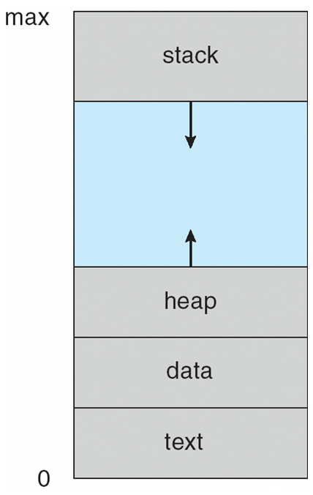
Process in Memory
Text
  Program code
Data
  Global variables
Stack
  Temporary data
  Function parameters, return addresses, local variables
Heap
  Dynamically allocated memory

Slide 23
Process State
As a process executes, it changes state
  New: The process is being created
  Running: Instructions are being executed
  Waiting: The process is waiting for some event to occur
  Ready: The process is waiting to be assigned to a processor
  Terminated: The process has finished execution

Slide 24
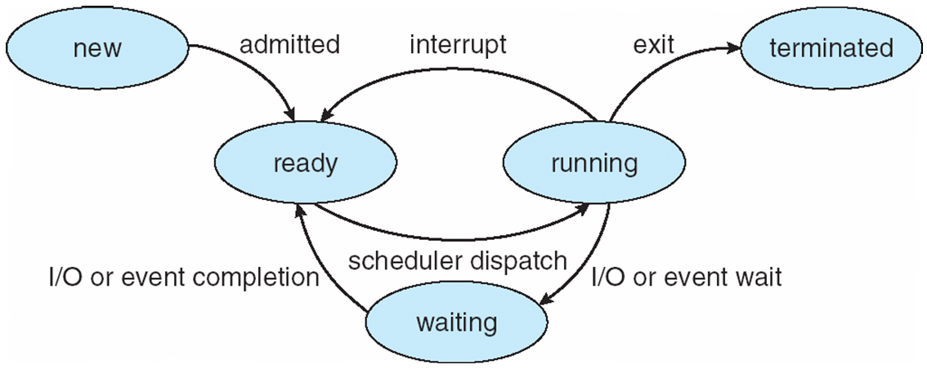
Diagram of Process State
Notes:
http://www.youtube.com/watch?v=bta48Ix3t_Q

Slide 25
Process Control Block (PCB)
Information associated with each process stored in the process table:
  Process state
  Program counter
  CPU registers
  CPU scheduling information
  Memory-management information
  Accounting information
  I/O status information

Slide 26
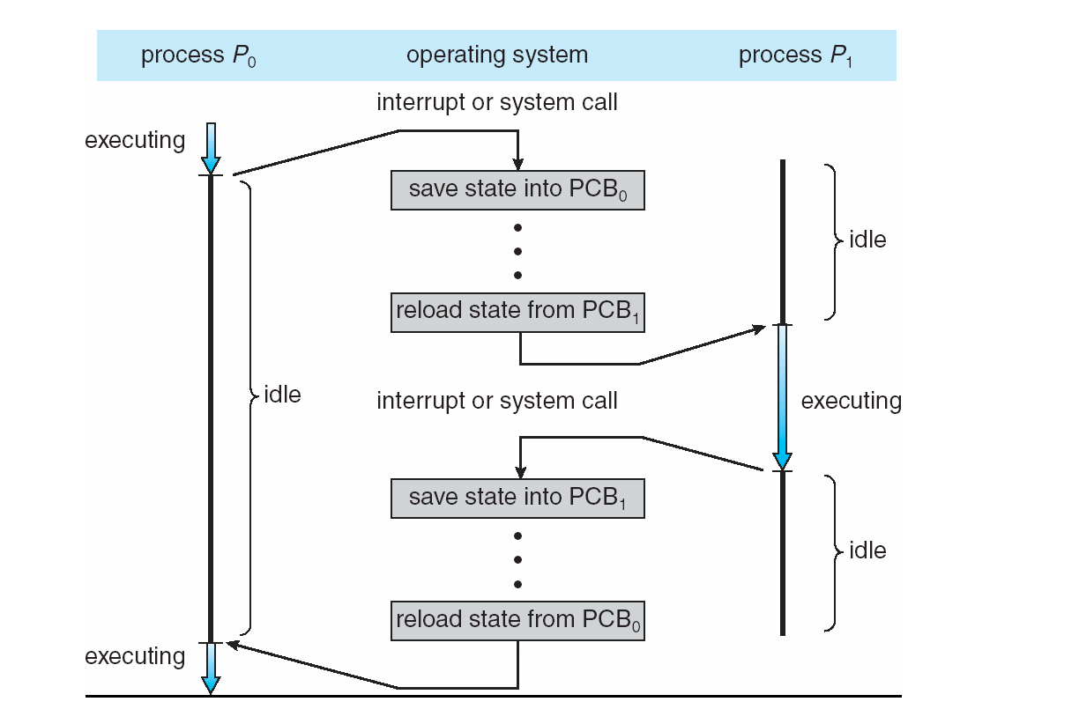
CPU Switch From Process to Process

Slide 27
Context Switch
Context switch
  When CPU switches to another process, the system must save the state of the old process and load the saved state for the new process
  Context of a process represented in the PCB
Context-switch time is pure overhead
  The system does no useful work while switching
  Time dependent on hardware support (typically a few milliseconds)

Slide 28
Process Creation
Parent process create children processes
  Each of these new processes may in turn create other processes, forming a tree of processes
  Process identified and managed via process identifier (pid)
Resource sharing
  Parent and children share all resources
  Children share subset of parent’s resources
  Parent and child share no resources
Execution
  Parent and children execute concurrently
  Parent waits until children terminate

Slide 29
Process Creation
Address space
  Child duplicate of parent
  Child has a program loaded into it
UNIX examples
  fork system call creates new process
  exec system call used after a fork to replace the process’ memory space with a new program

Slide 30
fork()
#include <sys/types.h>
#include <unistd.h>
pid_t fork( void );
Creates a child process by making a copy of the parent process --- an exact duplicate.
  Implicitly specifies code, registers, stack, data, files
Both the child and the parent continue running.

Slide 31
fork() as a diagram
Parent
pid = fork()
Child
Returns a new PID: e.g. pid == 5
pid == 0
Shared
Program
Data
Copied
Data

Slide 32
fork() Example (parentchild.c)
#include <stdio.h>
#include <sys/types.h>
#include <unistd.h>
int main()
{
pid_t pid; /* could be int */
int i;
pid = fork();
if( pid > 0 )
{
/* parent */
for( i=0; i < 1000; i++ )
printf(“\t\t\tPARENT %d\n”, i);
}
else
{
/* child */
for( i=0; I < 1000; i++ )
printf( “CHILD %d\n”, i );
}
return (0);
}

Slide 33
Possible Output
CHILD 0
CHILD 1
CHILD 2
PARENT 0
PARENT 1
PARENT 2
PARENT 3
CHILD 3
CHILD 4
PARENT 4
:

Slide 34
Parentchild Things to Note
i is copied between parent and child.
The switching between the parent and child depends on many factors:
  machine load, system process scheduling
I/O buffering effects amount of output shown.
Output interleaving is nondeterministic
  cannot determine output by looking at code

Slide 35
exec()
Family of functions for replacing process’s program with the one inside the exec() call.
e.g.
  #include <unistd.h>
  int execlp(char *file, char *arg0,
  char *arg1, ..., (char *)0);
  execlp(“sort”, “sort”, “-n”,
  “foobar”, (char *)0);
Same as "sort -n foobar"

Slide 36
menu.c
#include <stdio.h>
#include <unistd.h>
void main()
{ char *cmd[] = {“who”, “ls”, “date”};
int i;
printf(“0=who 1=ls 2=date : “);
scanf(“%d”, &i);
execlp( cmd[i], cmd[i], (char *)0 );
printf( “execlp failed\n” );
}

Slide 37
exec(..) Family
There are 6 versions of the exec function, and they all do about the same thing: they replace the current program with the text of the new program. Main difference is how parameters are passed.

Slide 38
Exec variations
There are 6 versions of the exec function, and they all do about the same thing: they replace the current program with the text of the new program. Main difference is how parameters are passed.
int execl( const char *path, const char *arg, ... );
int execlp( const char *file, const char *arg, ... );
int execle( const char *path, const char *arg , ..., char *const envp[] );
int execv( const char *path, char *const argv[] );
int execvp( const char *file, char *const argv[] );
int execve( const char *filename, char *const argv [], char *const envp[]);

Slide 39
fork() and execv()
execv(new_program, argv[ ])
Initial process
Fork
fork() returns pid=0 and runs as a cloned parent until execv is called
Returns a new PID
Original
process
Continues
New
Copy of
Parent
new_Program
(replacement)
execv(new_program)

Slide 40
wait()
#include <sys/types.h>
#include <sys/wait.h>
pid_t wait(int *statloc);
Suspends calling process until child has finished. Returns the process ID of the terminated child if ok, -1 on error.
statloc can be (int *)0 or a variable which will be bound to status info. about the child.

Slide 41
wait() Actions
A process that calls wait() can:
  suspend (block) if all of its children are still running, or
  return immediately with the termination status of a child, or
  return immediately with an error if there are no child processes.

Slide 42
menushell.c
#include <stdio.h>
#include <unistd.h>
#include <sys/types.h>
#include <sys/wait.h>
void main()
{
char *cmd[] = {“who”, “ls”, “date”};
int i;
while( 1 )
{
printf( 0=who 1=ls 2=date : “ );
scanf( “%d”, &i );
:
continued

Slide 43
if(fork() == 0)
{ /* child */
execlp( cmd[i], cmd[i], (char *)0 );
printf( “execlp failed\n” );
exit(1);
}
else
{ /* parent */
wait( (int *)0 );
printf( “child finished\n” );
}
} /* while */
} /* main */

Slide 44
Execution
menushell
fork()
child
cmd[i]
wait()
execlp()

Slide 45
Macros for wait (1)
WIFEXITED(status)
  Returns true if the child exited normally.
WEXITSTATUS(status)
  Evaluates to the least significant eight bits of the return code of the child which terminated, which may have been set as the argument to a call to exit( ) or as the argument for a return.
  This macro can only be evaluated if WIFEXITED returned non-zero.

Slide 46
Macros for wait (2)
WIFSIGNALED(status)
  Returns true if the child process exited because of a signal which was not caught.
WTERMSIG(status)
  Returns the signal number that caused the child process to terminate.
  This macro can only be evaluated if WIFSIGNALED returned non-zero.

Slide 47
waitpid()
#include <sys/types.h>
#include <sys/wait.h>
pid_t waitpid( pid_t pid, int *status, int opts )
waitpid - can wait for a particular child
pid < -1
  Wait for any child process whose process group ID is equal to the absolute value of pid.
pid == -1
  Wait for any child process.
  Same behavior which wait( ) exhibits.
  pid == 0
  Wait for any child process whose process group ID is equal to that of the calling process.

Slide 48
pid > 0
  Wait for the child whose process ID is equal to the value of pid.
  options
    Zero or more of the following constants can be ORed.
      WNOHANG
        Return immediately if no child has exited.
      WUNTRACED
        Also return for children which are stopped, and whose status has not been reported (because of signal).
  Return value
    The process ID of the child which exited.
    -1 on error; 0 if WNOHANG was used and no child was available.

Slide 49
Macros for waitpid
WIFSTOPPED(status)
  Returns true if the child process which caused the return is currently stopped.
  This is only possible if the call was done using WUNTRACED.
WSTOPSIG(status)
  Returns the signal number which caused the child to stop.
  This macro can only be evaluated if WIFSTOPPED returned non-zero.

Slide 50
Example: waitpid
#include <stdio.h>
#include <sys/wait.h>
#include <sys/types.h>
int main(void)
{
pid_t pid;
int status;
if( (pid = fork() ) == 0 )
{ /* child */
printf(“I am a child with pid = %d\n”,
getpid());
sleep(60);
printf(“child terminates\n”);
exit(0);
}

Slide 51
else
{ /* parent */
while (1)
{
waitpid( pid, &status, WUNTRACED );
if( WIFSTOPPED(status) )
{
printf(“child stopped, signal(%d)\n”,
WSTOPSIG(status));
continue;
}
else if( WIFEXITED(status) )
printf(“normal termination with
status(%d)\n”,
WEXITSTATUS(status));
else if (WIFSIGNALED(status))
printf(“abnormal termination,
signal(%d)\n”,
WTERMSIG(status));
exit(0);
} /* while */
} /* parent */
} /* main */

Slide 52
Process Data
Since a child process is a copy of the parent, it has copies of the parent’s data.
A change to a variable in the child will not change that variable in the parent.

Slide 53
Example (globex.c)
#include <stdio.h>
#include <sys/types.h>
#include <unistd.h>
int globvar = 6;
char buf[] = “stdout write\n”;
int main(void)
{
int w = 88;
pid_t pid;
continued

Slide 54
write( 1, buf, sizeof(buf)-1 );
printf( “Before fork()\n” );
if( (pid = fork()) == 0 )
{ /* child */
globvar++;
w++;
}
else if( pid > 0 ) /* parent */
sleep(2);
else
perror( “fork error” );
printf( “pid = %d, globvar = %d, w = %d\n”,
getpid(), globvar, w );
return 0;
} /* end main */

Slide 55
Output
$ globex
stdout write /* write not buffered */
Before fork()
pid = 430, globvar = 7, w = 89
/*child chg*/
pid = 429, globvar = 6, w = 88
/* parent no chg */
$ globex > temp.out
$ cat temp.out
stdout write
Before fork()
pid = 430, globvar = 7, w = 89
Before fork() /* fully buffered */
pid = 429, globvar = 6, w = 88

Slide 56
Process File Descriptors
A child and parent have copies of the file descriptors, but the R-W pointer is maintained by the system:
  the R-W pointer is shared
This means that a read() or write() in one process will affect the other process since the R-W pointer is changed.

Slide 57
Example: File used across processes
(shfile.c)
#include <stdio.h>
#include <sys/types.h>
#include <sys/wait.h>
#include <unistd.h>
#include <fcntl.h>
void printpos(char *msg, int fd);
void fatal(char *msg);
int main(void)
{ int fd; /* file descriptor */
pid_t pid;
char buf[10]; /* for file data */
:
continued

Slide 58
if ((fd=open(“data-file”, O_RDONLY)) < 0)
perror(“open”);
read(fd, buf, 10); /* move R-W ptr */
printpos( “Before fork”, fd );
if( (pid = fork()) == 0 )
{ /* child */
printpos( “Child before read”, fd );
read( fd, buf, 10 );
printpos( “ Child after read”, fd );
}
:
continued

Slide 59
else if( pid > 0 )
{ /* parent */
wait((int *)0);
printpos( “Parent after wait”, fd );
}
else
perror( “fork” );
}
continued

Slide 60
void printpos( char *msg, int fd )
/* Print position in file */
{
long int pos;
if( (pos = lseek( fd, 0L, SEEK_CUR) ) < 0L )
perror(“lseek”);
printf( “%s: %ld\n”, msg, pos );
}

Slide 61
Output
$ shfile
Before fork: 10
Child before read: 10
Child after read: 20
Parent after wait: 20

Slide 62
Special Exit Cases
Two special cases:
1) A child exits when its parent is not currently executing wait()
  the child becomes a zombie
  status data about the child is stored until the parent does a wait()
continued

Slide 63
2) A parent exits when 1 or more children are still running
  children are adopted by the system’s initialization process (/etc/init)
    it can then monitor/kill them

Slide 64
I/O redirection
The trick: you can change where the standard I/O streams are going/coming from after the fork but before the exec

Slide 65
Redirection of standard output
Example implement shell: ls > x.ls
program:
  Open a new file x.lis
  Redirect standard output to x.lis using dup command
    everything sent to standard output ends in x.lis
  execute ls in the process
dup2(int fin, int fout) - copies fin to fout in the file table
File table
dup2(3,1)
stdin
stdin
0
1
2
3
4
0
1
2
3
4
stdout
stderr
x.lis
x.lis

Slide 66
Example - implement ls > x.lis
#include <unistd.h>
int main ()
{
int fileId;
fileId = creat( "x.lis",0640 );
if( fileId < 0 )
{
printf( stderr, "error creating x.lis\n" );
exit (1);
}
dup2( fileId, fileno(stdout) ); /* copy fileID to stdout */
close( fileId );
execl( "/bin/ls", "ls", 0 );
}

Slide 67
User and Group ID
Group ID
  Real, effective
User ID
  Real user ID
    Identifies the user who is responsible for the running process.
  Effective user ID
    Used to assign ownership of newly created files, to check file access permissions, and to check permission to send signals to processes.
    To change euid: executes a setuid-program that has the set-uid bit set or invokes the setuid( ) system call.
    The setuid(uid) system call: if euid is not superuser, uid must be the real uid or the saved uid (the kernel also resets euid to uid).
  Real and effective uid: inherit (fork), maintain (exec).

Slide 68
Read IDs
pid_t getuid(void);
  Returns the real user ID of the current process
pid_t geteuid(void);
  Returns the effective user ID of the current process
gid_t getgid(void);
  Returns the real group ID of the current process
gid_t getegid(void);
  Returns the effective group ID of the current process

Slide 69
Change UID and GID (1)
#include <unistd.h>
#include <sys/types.h>
int setuid( uid_t uid )
Int setgid( gid_t gid )
Sets the effective user ID of the current process.
  Superuser process resets the real effective user IDs to uid.
  Non-superuser process can set effective user ID to uid, only when uid equals real user ID or the saved set-user ID (set by executing a setuid-program in exec).
  In any other cases, setuid returns error.

Slide 70
Change UID and GID (2)
ID
exec
setuid(uid)
suid bit off
suid bit on
superuser
other users
real-uid
effective-uid
saved set-uid
unchanged
unchanged
copied from
euid
unchanged
set from user
ID of program
file
copied from
euid
uid
uid
uid
unchanged
uid
unchanged

Slide 71
Change UID and GID (3)
#include <unistd.h>
#include <sys/types.h>
int setreuid( uid_t ruid, uid_t euid )
Sets real and effective user ID’s of the current process.
Un-privileged users may change the real user ID to the effective user ID and vice-versa.
It is also possible to set the effective user ID from the saved user ID.
Supplying a value of -1 for either the real or effective user ID forces the system to leave that ID unchanged.
If the real user ID is changed or the effective user ID is set to a value not equal to the previous real user ID, the saved user ID will be set to the new effective user ID.

Slide 72
Change UID and GID (4)
  int seteuid(uid_t euid);
    seteuid(euid) is functionally equivalent to setreuid(-1, euid).
    Setuid-root program wishing to temporarily drop root privileges, assume the identity of a non-root user, and then regain root privileges afterwards cannot use setuid, because setuid issued by the superuser changes all three IDs. One can accomplish this with seteuid.
  int setregid(gid_t rgid, gid_t egid);
  int setegid(gid_t egid);

Slide 73
Environment
extern char **environ;
int main( int argc, char *argv[ ], char *envp[ ] )
environment
pointer
environment
list
environment
strings
environ:
HOME=/home/stevens\0
PATH=:/bin:/usr/bin\0
SHELL=/bin/sh\0
USER=stevens\0
LOGNAME=stevens\0
NULL

Slide 74
Example: environ
#include <stdio.h>
void main( int argc, char *argv[], char *envp[] )
{
int i;
extern char **environ;
printf( “from argument envp\n” );
for( i = 0; envp[i]; i++ )
puts( envp[i] );
printf(“\nFrom global variable environ\n”);
for( i = 0; environ[i]; i++ )
puts(environ[i]);
}

Slide 75
getenv
#include <stdlib.h>
char *getenv(const char *name);
  Searches the environment list for a string that matches the string pointed to by name.
  Returns a pointer to the value in the environment, or NULL if there is no match.

Slide 76
putenv
#include <stdlib.h>
int putenv(const char *string);
  Adds or changes the value of environment variables.
  The argument string is of the form name=value.
  If name does not already exist in the environment, then string is added to the environment.
  If name does exist, then the value of name in the environment is changed to value.
  Returns zero on success, or -1 if an error occurs.

Slide 77
Example : getenv, putenv
#include <stdio.h>
#include <stdlib.h>
void main(void)
{
printf(“Home directory is %s\n”, getenv(“HOME”));
putenv(“HOME=/”);
printf(“New home directory is %s\n”, getenv(“HOME”));
}

Slide 78
Pipe call
To create a pipe, the kernel sets up two file descriptors for use by the pipe.
One descriptor is used to allow a path of input into the pipe (write)
One descriptor is used to obtain data from the pipe (read).
When the pipe is created the process can only talk to itself.

Slide 79
Pipe communications
The creating process usually forks a child process after the pipe is created.
The child process will inherit any open file descriptors from the parent.
This gives us the basis for multiprocess communication (between parent and child).
Processes must agree on which way communication will go.

Slide 80
Pipes
After fork
Parent Process
Parent Process
Now called child
stdin
stdout
stdin
stdout

Slide 81
Pipes Con’t
After exec
Parent Process
Child Process
stdin
stdout
stdin
stdout

Slide 82
Pipe Communications Con’t
If the parent is sending to the child:
  The parent process will then close the end of the pipe to receive information.
  The child process will then close the end of the pipe to send information.
If the child is sending to the parent it would be opposite.

Slide 83
Pipe Intro
With a pipe
pipe
Parent Process
stdout
stdin
Child Process
stdin
stdout

Slide 84
Using the pipe
To access a pipe directly, the same system calls that are used for low-level file I/O can be used.
To send data to the pipe, we use the write() system call, and to retrieve data from the pipe, we use the read() system call.
Remember, low-level file I/O system calls work with file descriptors!
However, keep in mind that certain system calls, such as lseek(), do not work with descriptors to pipes.

Slide 85
Sample
if(childpid == 0)
{
/* Child process closes up input side of pipe */
close(fd[0]);
/* Send "string" through the output side of pipe */
write(fd[1], string, (strlen(string)+1));
exit(0);
}
else
{
/* Parent process closes up output side of pipe */
close(fd[1]);
/* Read in a string from the pipe */
nbytes = read(fd[0], readbuffer, sizeof(readbuffer));
printf("Received string: %s", readbuffer);
}
return(0);
}
#include <stdio.h>
#include <unistd.h>
#include <sys/types.h>
int main(void)
{
int fd[2], nbytes;
pid_t childpid;
char string[] = "Hello, world!\n";
char readbuffer[80];
pipe(fd);
if((childpid = fork()) == -1)
{
perror("fork");
exit(1);
}

